Slide 1
Matrices & Daily Applications
By: Meshach Santos

Slide 2
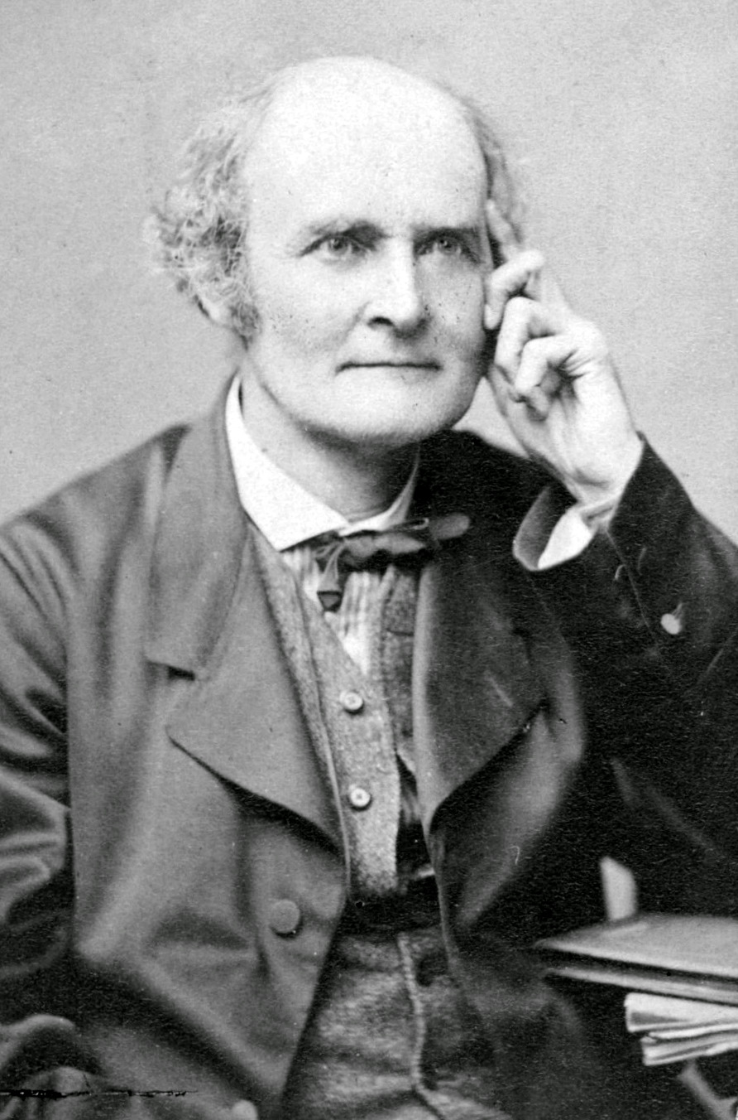
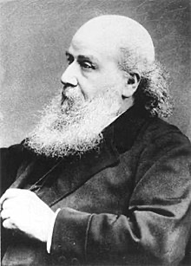
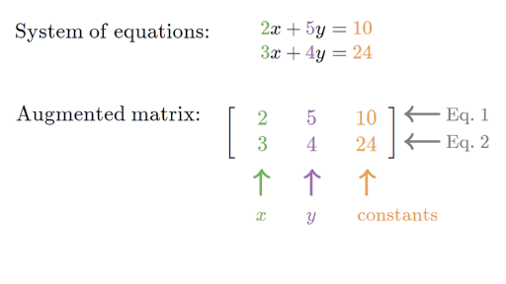
Origins
The term Matrix was introduced in 19th century England
Termed by James Sylvester
Developed by Arthur Cayley
Wrote the aspect of matrices in two papers in the 1850’s

Slide 3
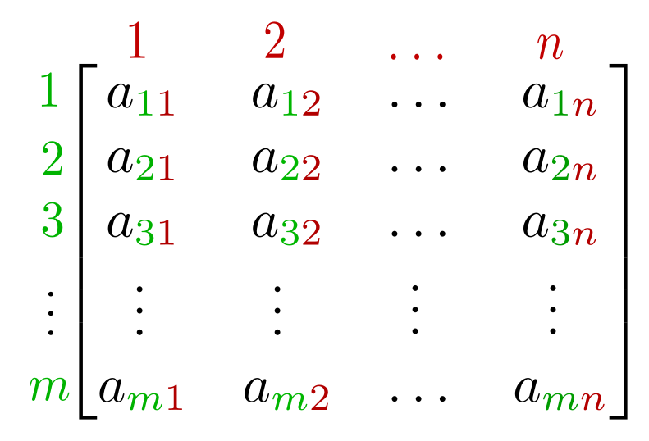
What are Matrices?
AKA Rectangular Grids
Math: Set of numbers laid out in rows & columns
CS: A surrounding medium or structure; Environment in where something develops
Collection of numbers or data in a single place for later use

Slide 4
Matrices break down
a: the value of the element
GS: row number element is found
RS: column number element is found
m: mth row element is located
n: nth column element is located

Slide 5
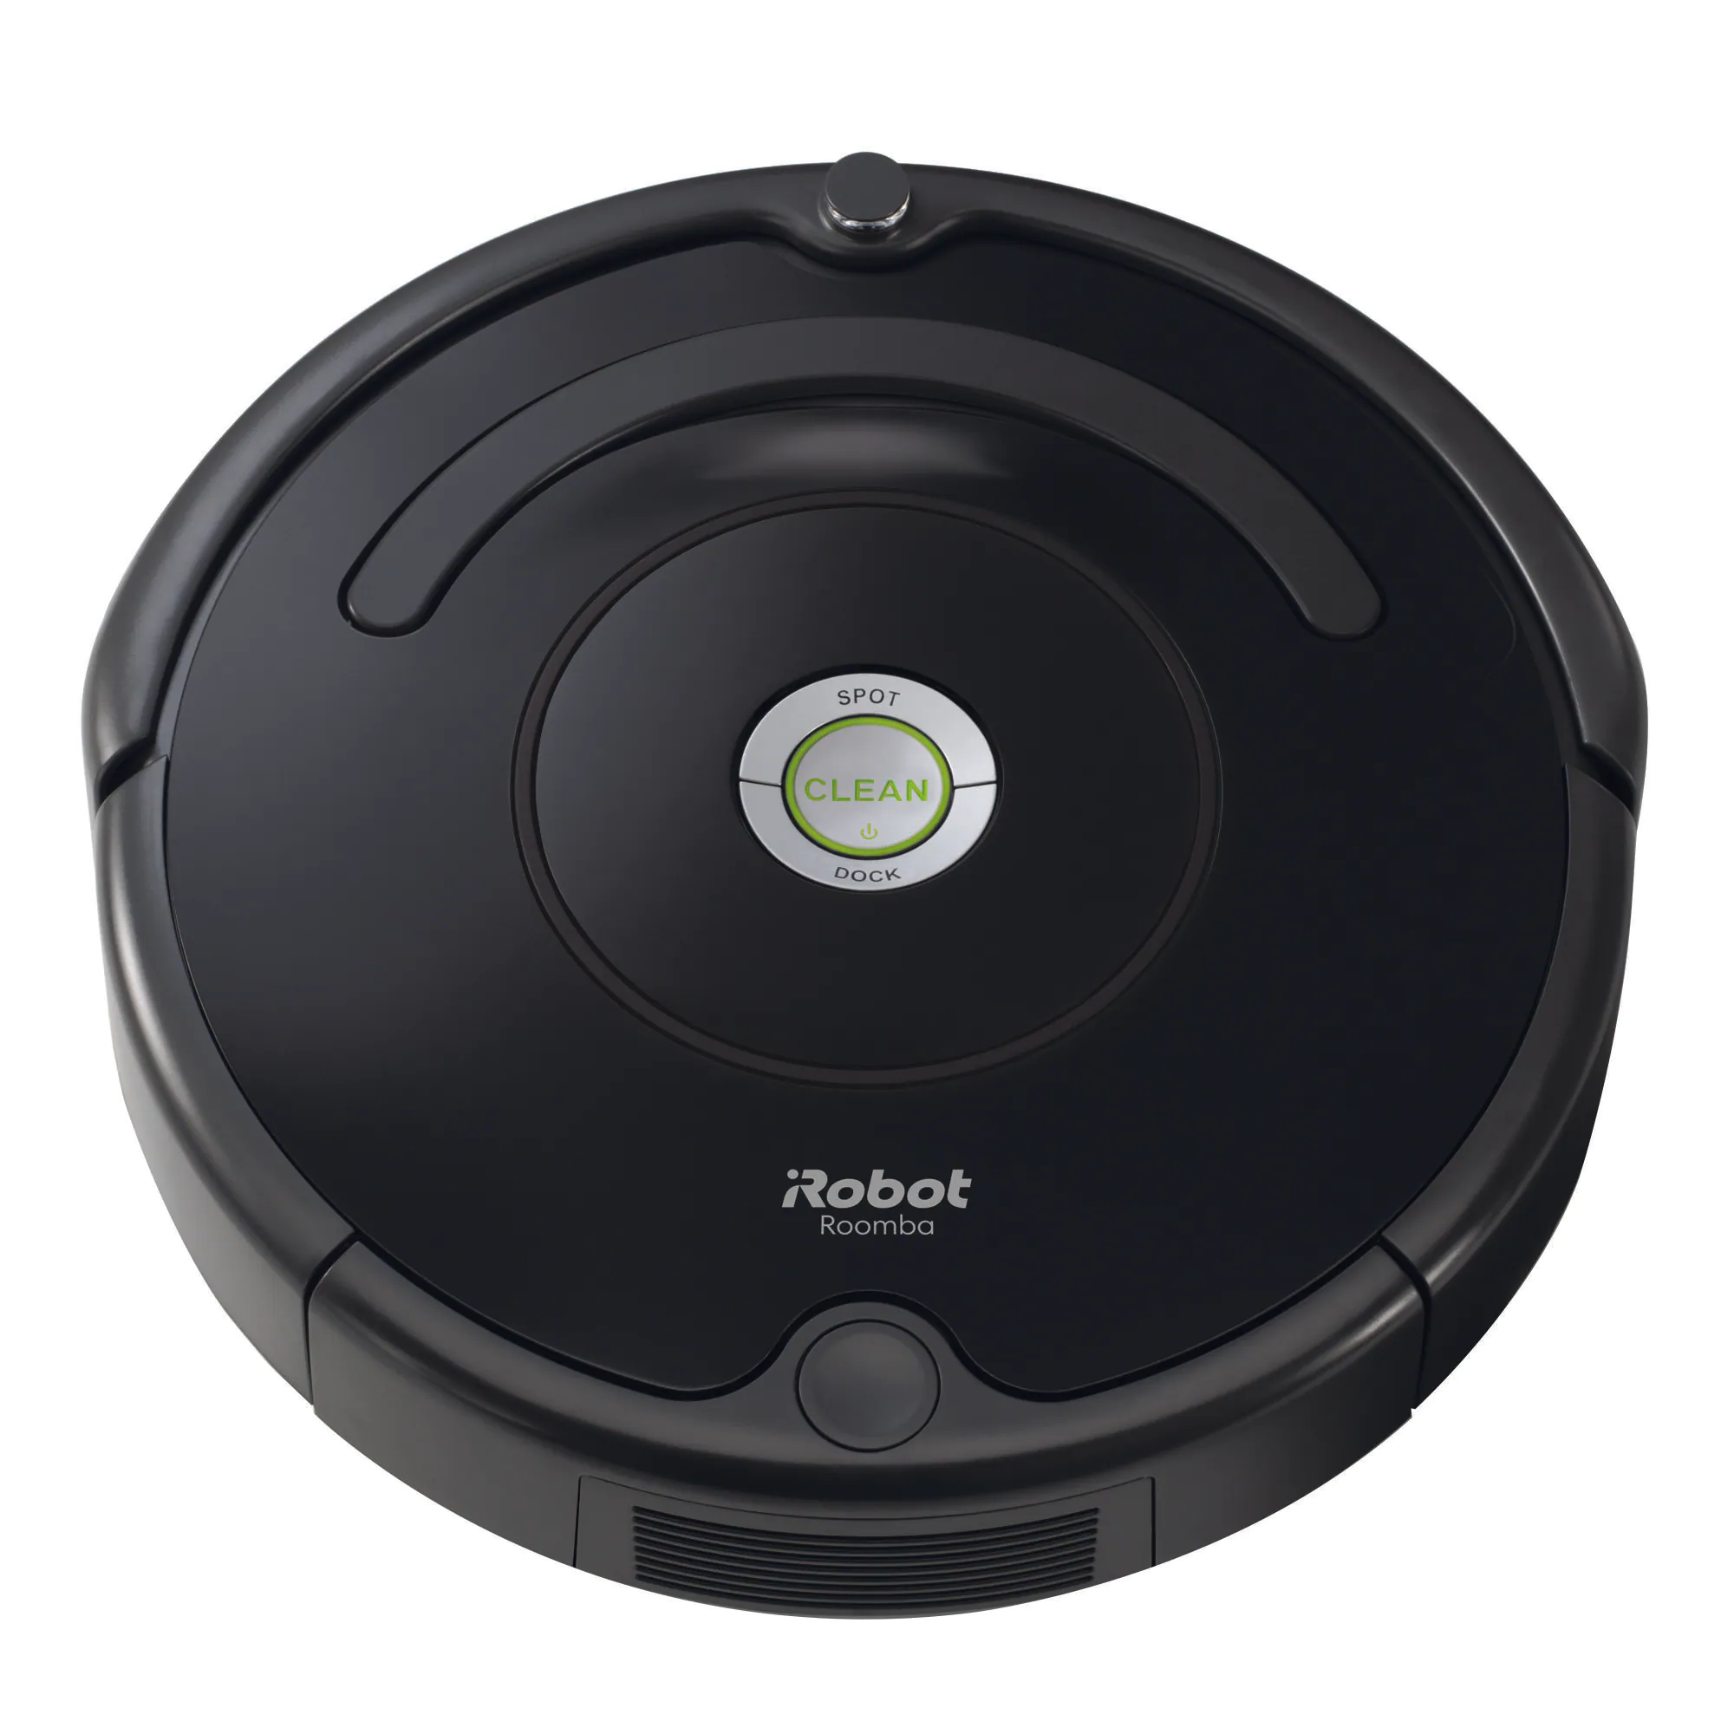
Purpose
Provide quick approximations of more complicated calculations
Robotics: Determines the position of objects with HTM
Encryption: Encrypt and decrypt messages with a key matrix
Finances: Helps navigate through different loan options or investment growth

Slide 6
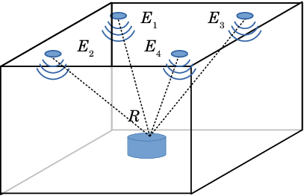
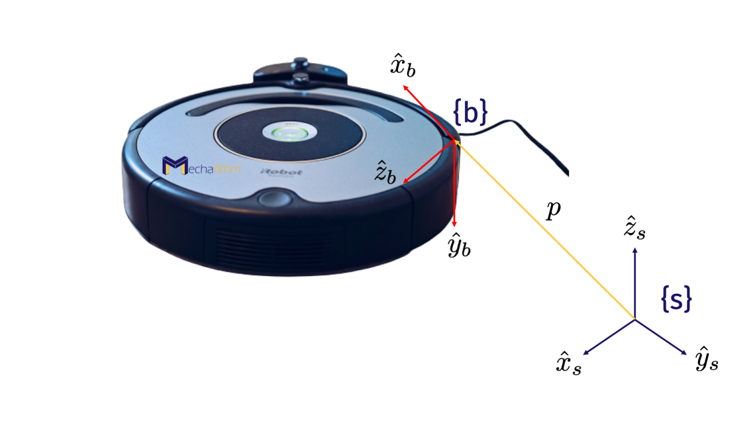
Robotics
Planes in a graph,vectors, angles
HTM (Homogeneous Transformation Matrices)
This can determine the position of objects such as itself to correspond to that location
Achieves by using vectors or a frame to displace it (rotates or translates)
Ex: Roomba

Slide 7
Encryption
20
19
4
18
𝑈𝑇𝐸𝑆 = 20 19 4 18 =
Hills Cyphers Method
ABC’s translated to Numbers
A = 0, B =1, … , Z =25
Uses “key matrices”(KM) to encrypt or decrypt messages
Achieves this by using the KM and the message wanting to be sent
If KxK, will have K elements split
Then multiply KM by the assigned number of message letter
Mod26 the results due to domain (0,25)
Result: UTES encrypted is VLII
To reverse, use inverse * encrypted numbers
4 | 1
3 | 7
(KM)
K =
Encryption:
20
19
4 | 1
3 | 7
99
198
21
11
Mod26
X
=
=
4 | 1
3 | 7
34
138
4
18
8
8
X
=
Mod26
=

Slide 8
What if matrices never existed?
No neat or efficient ways to collect usable data
Simple encryption method would not been plausible
Finances would be extremely precise and very specific to order around (visual aspect is harder)
Robotics locomotive issue
Computational data storage would take up more space and use more time to process when sending it

Slide 9
Bibliography
https://www.britannica.com/science/matrix-mathematics
https://www.britannica.com/science/matrix-mathematics
https://techmonitor.ai/what-is/what-is-a-matrix-4964527
https://www.researchgate.net/publication/322337716_Application_of_Homogeneous_Transformation_Matrices_to_the_Simulation_of_VLP_Systems
https://www.mecharithm.com/homogenous-transformation-matrices-configurations-in-robotics/
https://www.math.utah.edu/~gustafso/s2017/2270/projects-2017/joePuglianoBrandonSehestedt/LinearAlgebra_Project.pdf

