Slide 1
Matrices
Mike Petrus
CS 131
And Image Processing

Slide 2
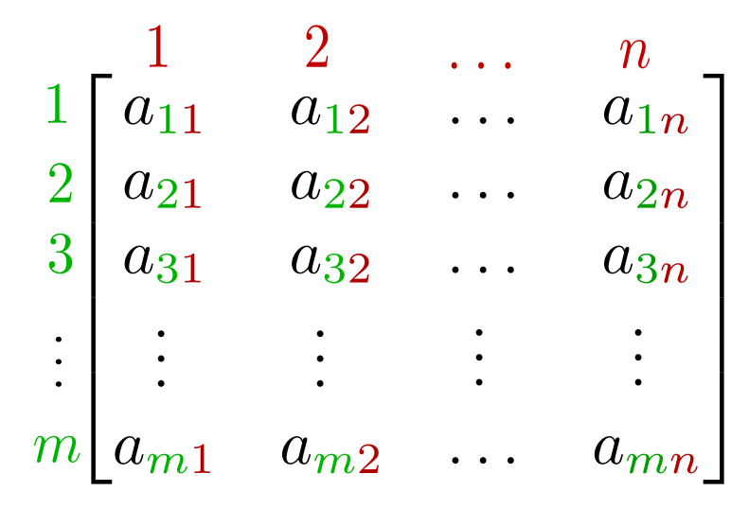
What is a Matrix
A matrix is a rectangular array of numbers or values
An m x n matrix has m rows and n columns
Each element can be denoted by a subscript based on its position in each row/column

Slide 3
Matrix Addition
Matrix addition: simply add corresponding entries to from each matrix to get the result
Matrices must be the same size

Slide 4
Scalar Multiplication of Matrices
If A = [a_{ij}] is an m × n matrix and c is a scalar, then the scalar multiple of A by c is the m × n matrix cA = [ca_{ij}].

Slide 5
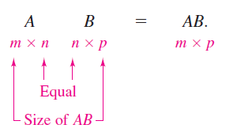
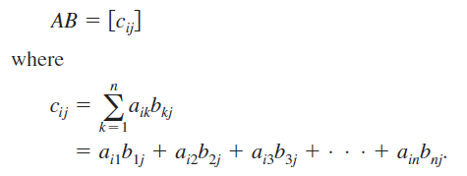
Matrix Multiplication
Multiplication of 2 matrices with each other
If A is an m × n matrix and B is an n × p matrix, then the product AB is an m × p matrix
The resultant matrix is the size of the two outer dimensions
The two inner dimensions must be equal
AB is not = BA
In this example BA would be undefined

Slide 6
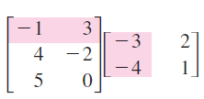
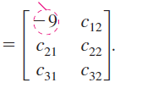
Matrix Multiplication
A
B
AB

Slide 7
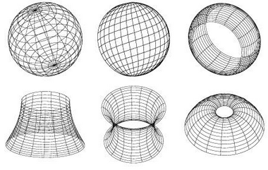
Applications of Matrices
Image Processing
Image/Facial Recognition
AI/Machine Learning
3D graphics

Slide 8
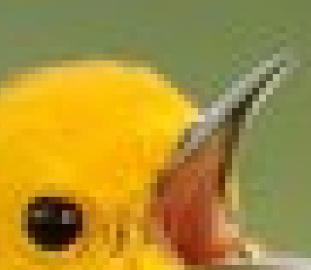
Images as Matrices

Slide 9
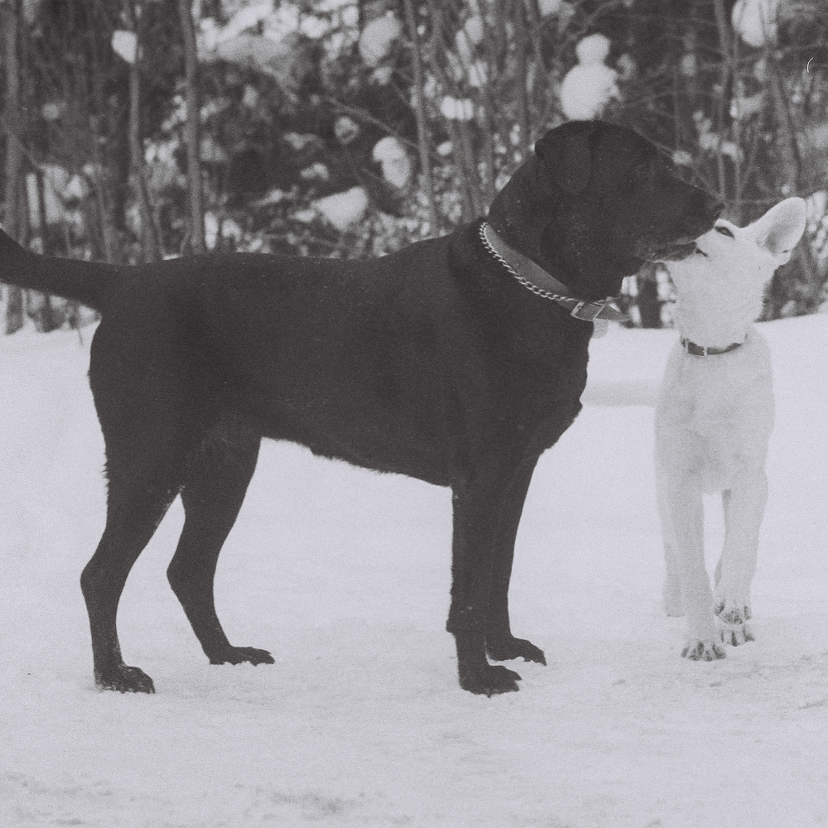
255
1000 x 1000
9 x 9
…
…
…
128
…
…
…
0

Slide 10
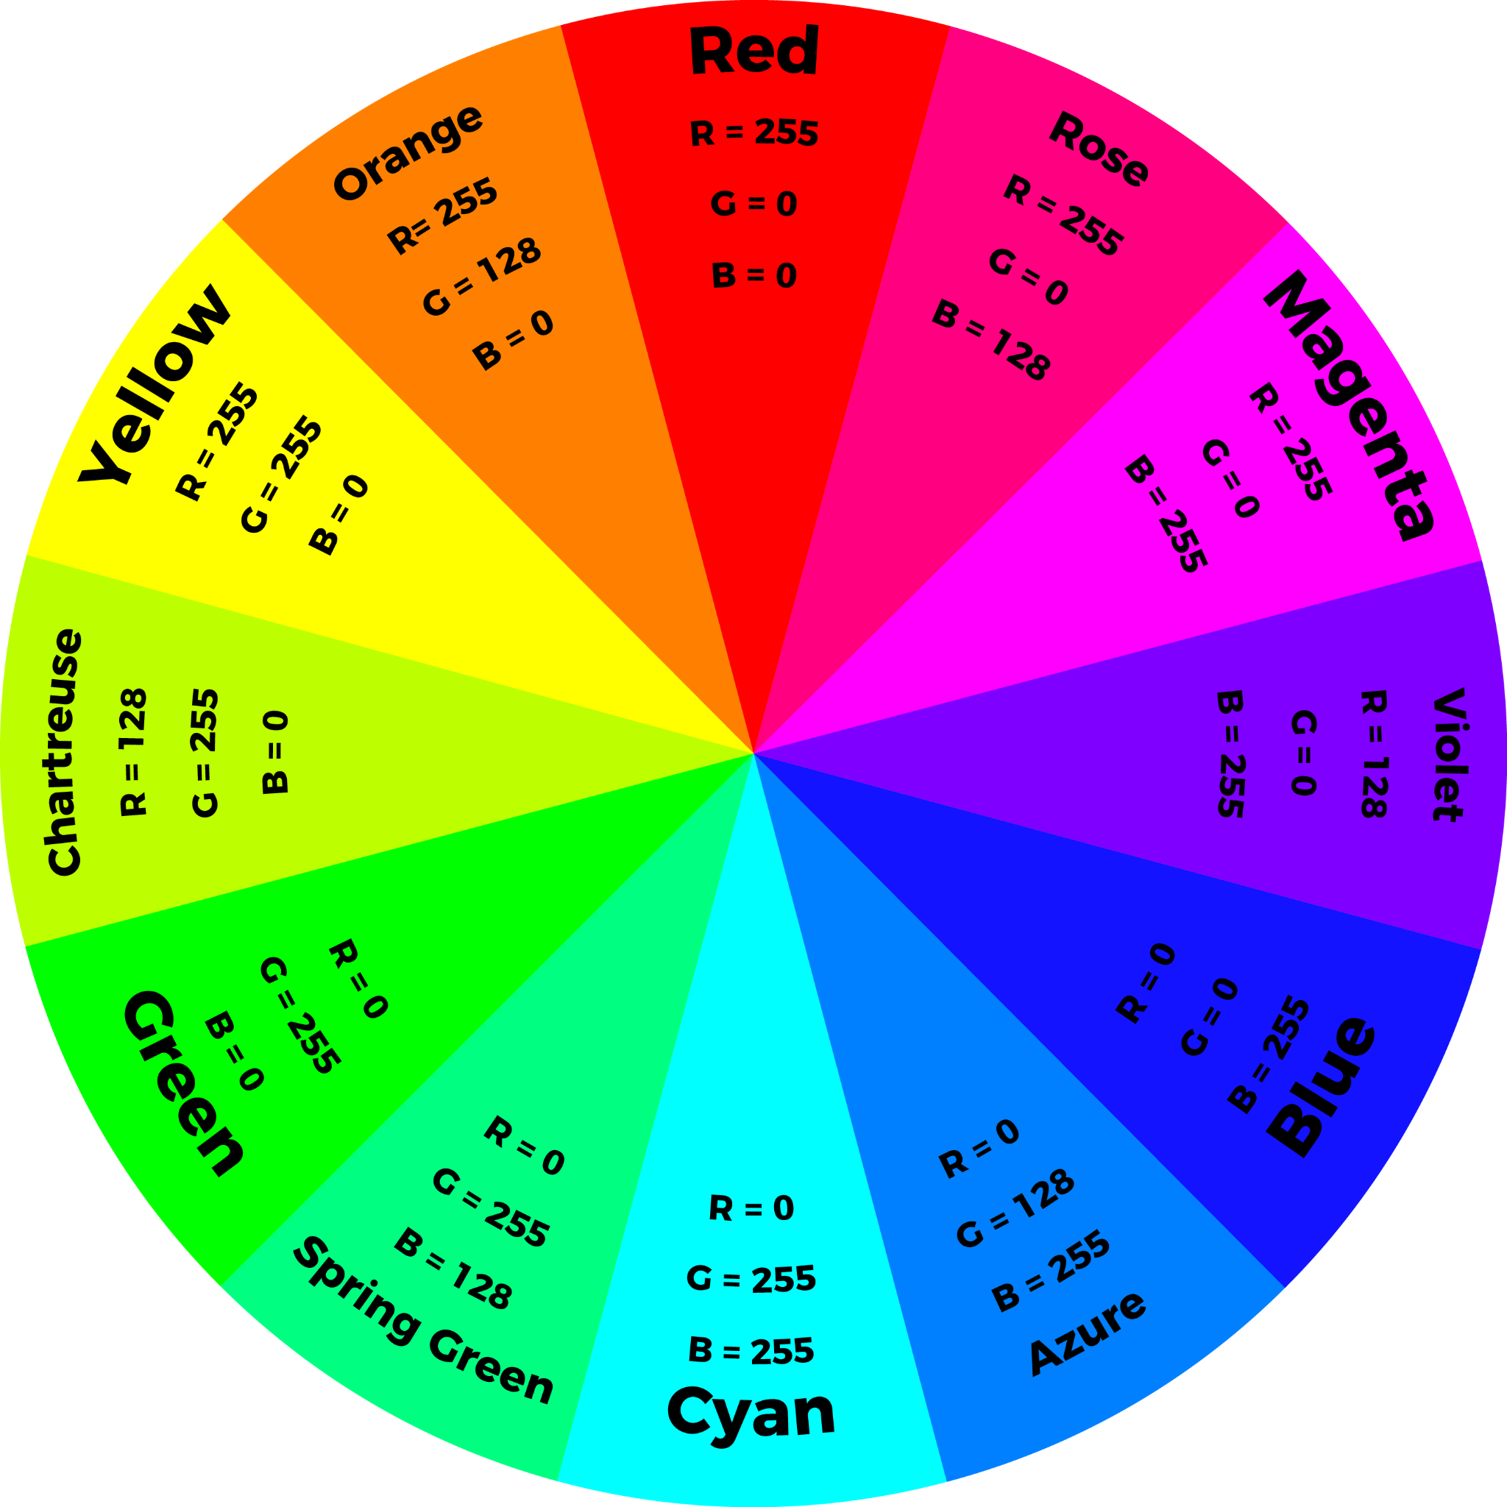
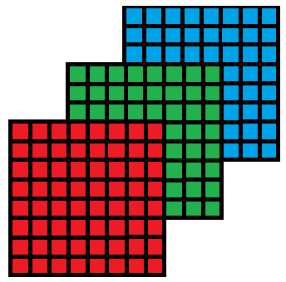
RGB colors
We can represent a full color scale with matrices of red, green, and blue
By assigning a value and overlapping the 3 matrices we can create new colors
Each color has a value between 0 - 255
256³ =~ 16.7 million color combinations

Slide 11
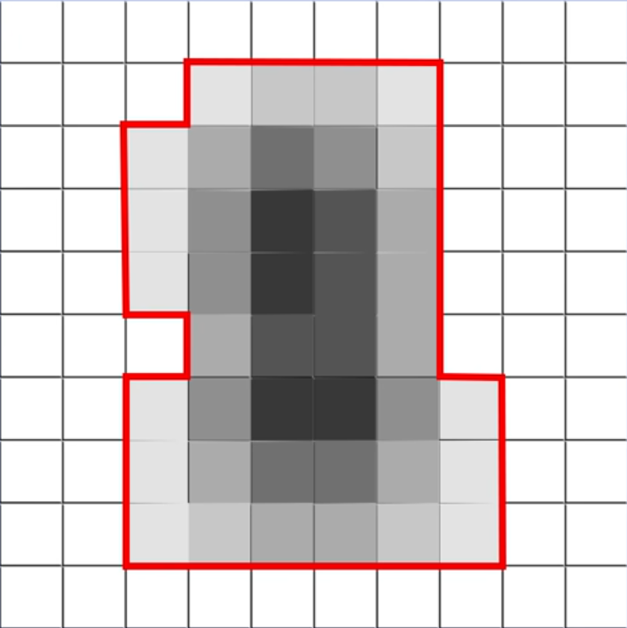
255 | 255 | 255 | 255 | 255 | 255 | 255 | 255 | 255 | 255
255 | 255 | 255 | 255 | 255 | 255 | 255 | 255 | 255 | 255
255 | 255 | 255 | 255 | 0 | 0 | 255 | 255 | 255 | 255
255 | 255 | 255 | 0 | 0 | 0 | 255 | 255 | 255 | 255
255 | 255 | 255 | 255 | 0 | 0 | 255 | 255 | 255 | 255
255 | 255 | 255 | 255 | 0 | 0 | 255 | 255 | 255 | 255
255 | 255 | 255 | 255 | 0 | 0 | 255 | 255 | 255 | 255
255 | 255 | 255 | 0 | 0 | 0 | 0 | 255 | 255 | 255
255 | 255 | 255 | 255 | 255 | 255 | 255 | 255 | 255 | 255
255 | 255 | 255 | 255 | 255 | 255 | 255 | 255 | 255 | 255
Image Processing: Blur
1/9 | 1/9 | 1/9
1/9 | 1/9 | 1/9
1/9 | 1/9 | 1/9
255
X
=
227
Kernel

Slide 12
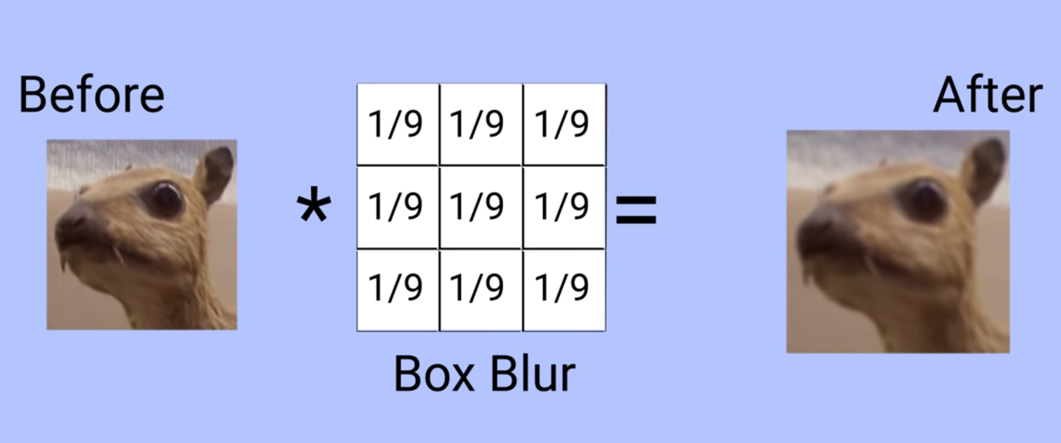
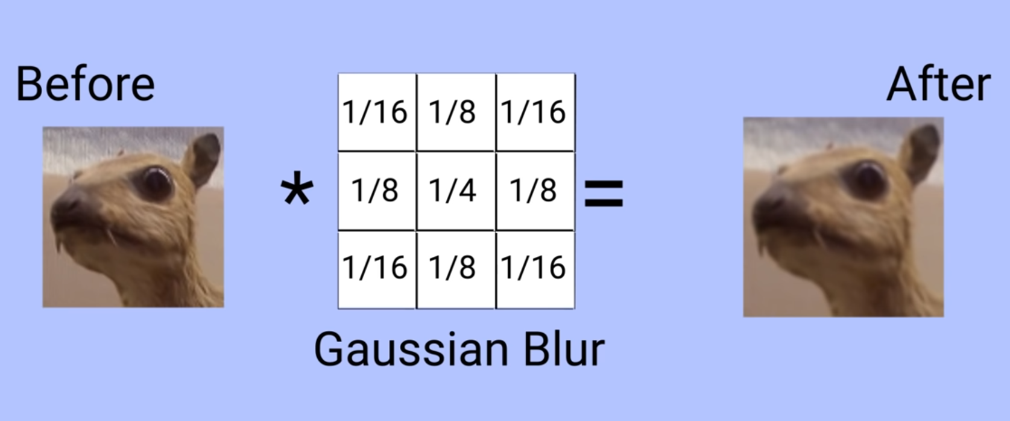
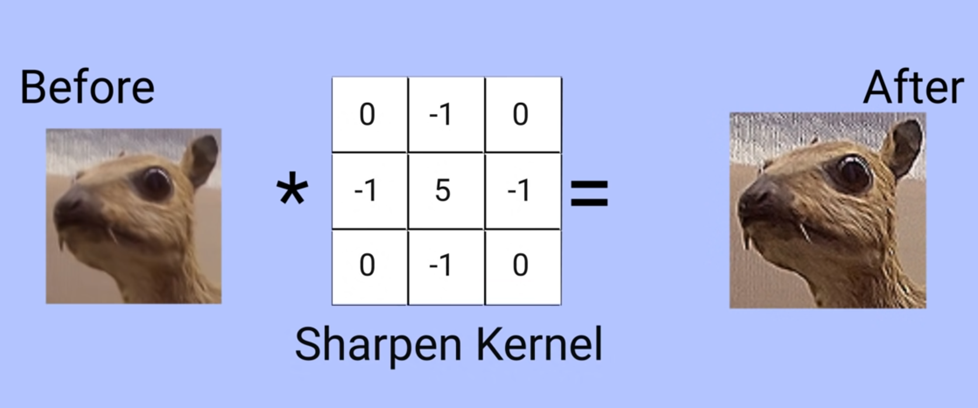
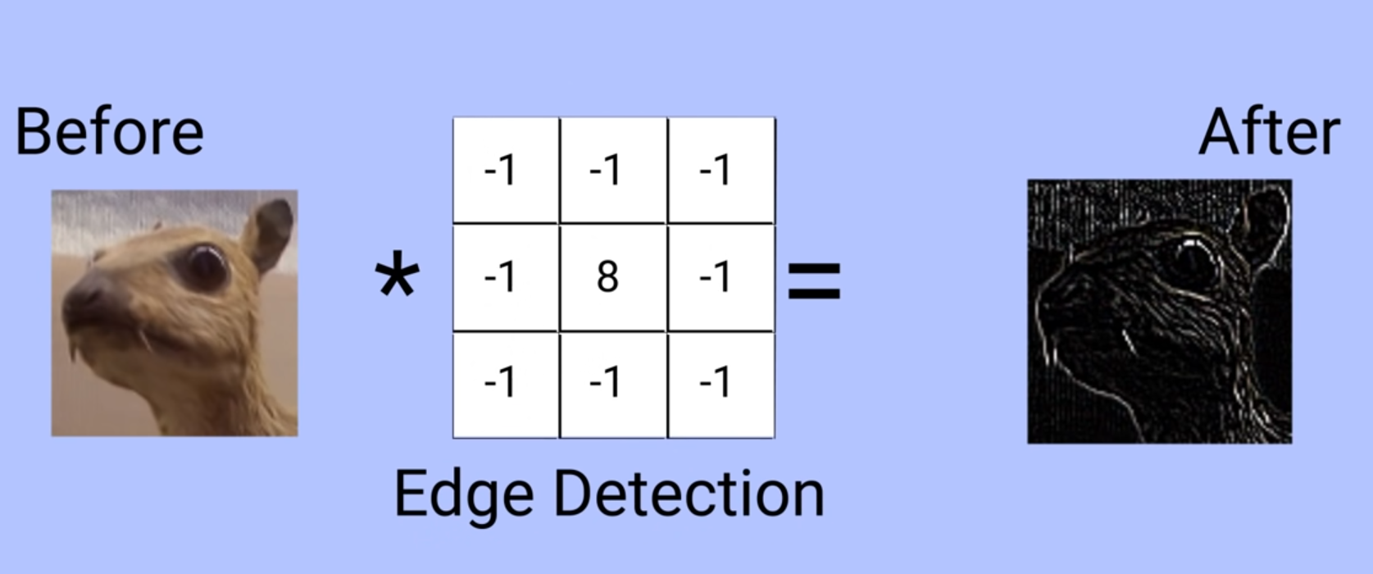
Other Kernels

Slide 13
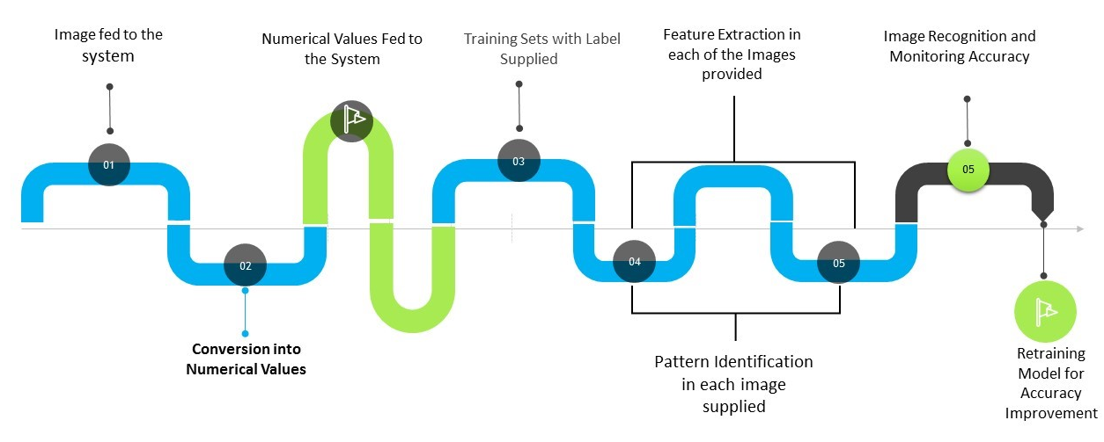
Image Recognition and Machine Learning
255 | 255 | 255 | 255 | 255 | 255 | 255
255 | 255 | 255 | 0 | 255 | 255 | 255
255 | 255 | 0 | 0 | 0 | 255 | 255
255 | 0 | 0 | 0 | 0 | 0 | 255
255 | 255 | 0 | 0 | 0 | 255 | 255
255 | 255 | 255 | 0 | 255 | 255 | 255
255 | 255 | 255 | 255 | 255 | 255 | 255

Slide 14
Conclusion
Matrices are a powerful way of organizing data sets
They allow us to convert complex objects into more manageable sets of data
We can then manipulate these large sets of data using simple mathematical operations
We can also use this data to create models of the real world and simulations that otherwise wouldn’t be possible

